Slide 1
데이터 정제 -빠진 데이터, 이상한 데이터 제거하기

Slide 2
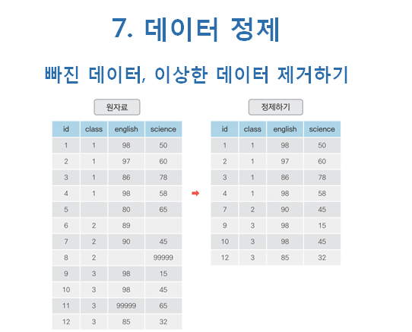

Slide 3

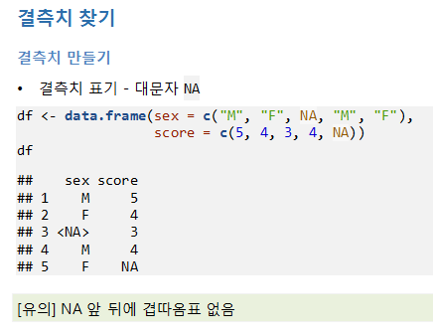

Slide 4
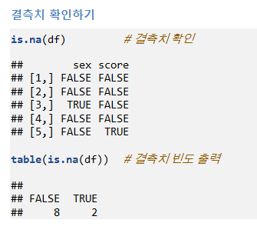
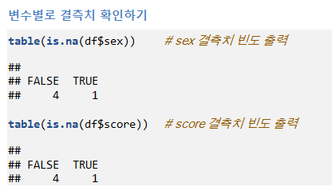

Slide 5
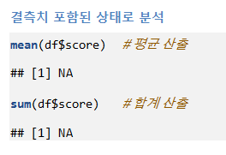
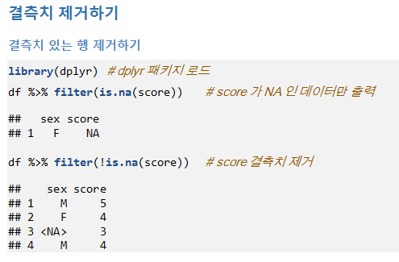

Slide 6
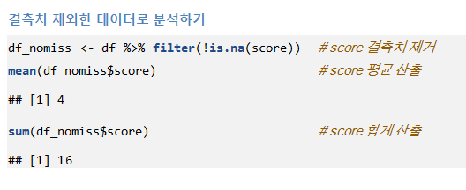
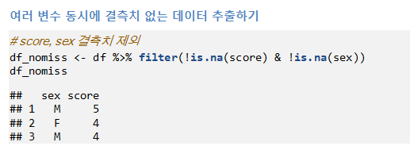

Slide 7
df<-data.frame(sex=c("M","F",NA,"M","F"),score=c(5,4,3,4,NA))
df
is.na(df)
table(is.na(df))
table(is.na(df$sex))
table(is.na(df$score))
mean(df$score)
sum(df$score)
df_nomiss<-df %>% filter(!is.na(score))
mean(df_nomiss$score)
sum(df_nomiss$score)
df_nomiss<-df%>% filter(!is.na(score)&!is.na(sex))
df_nomiss

Slide 8
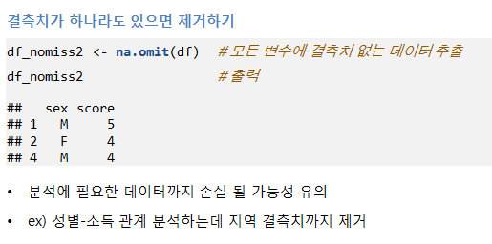
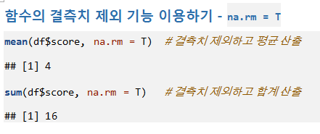

Slide 9
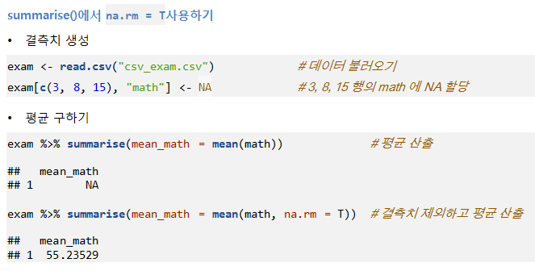

Slide 10
df_nomiss2<-na.omit(df)
df_nomiss2
mean(df$score,na.rm=T)
sum(df$score,na.rm=T)
exam<-read.csv("csv_exam.csv")
exam[c(3,8,15),"math"]<-NA
exam %>% summarise(mean_math=mean(math))
exam %>% summarise(mean_math=mean(math,na.rm=T))

Slide 11
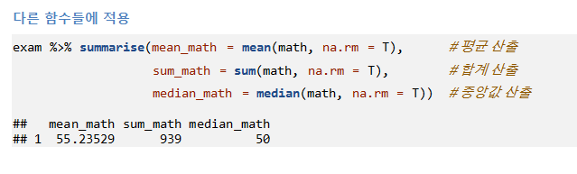


Slide 12
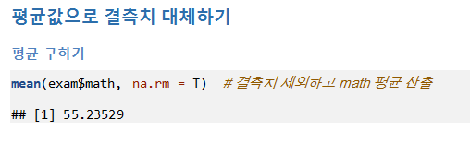
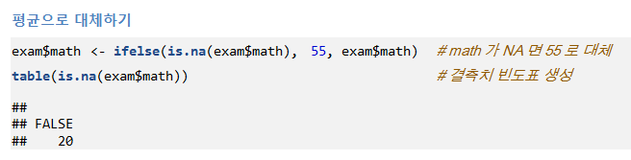

Slide 13
exam %>% summarise(mean_math=mean(math,na.rm=T),sum_math=sum(math,na.rm=T),median_math=median(math,na.rm=T))
mean(exam$math,na.rm=T)
exam$math<-ifelse(is.na(exam$math),55,exam$math)
table(is.na(exam$math))

Slide 14
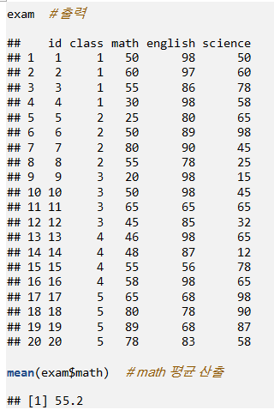

Slide 15
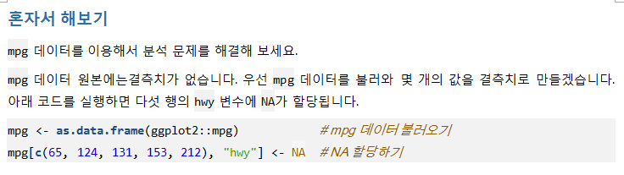



Slide 16
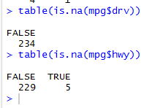
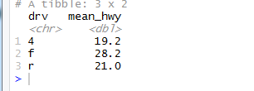
mpg<-as.data.frame(ggplot2::mpg)
mpg[c(65,124,131,153,212),"hwy"]<-NA
is.na(mpg)
table(is.na(mpg$drv))
table(is.na(mpg$hwy))
mpg %>%
filter(!is.na(hwy)) %>%
group_by(drv) %>%
summarise(mean_hwy=mean(hwy))

Slide 17

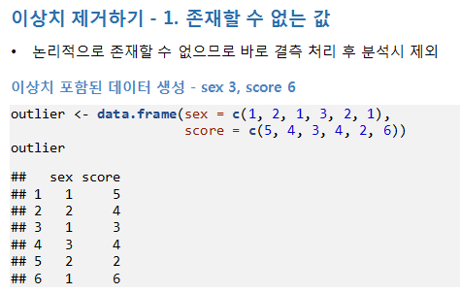

Slide 18
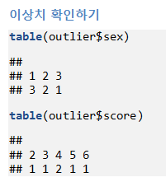
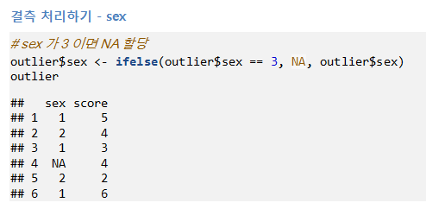

Slide 19
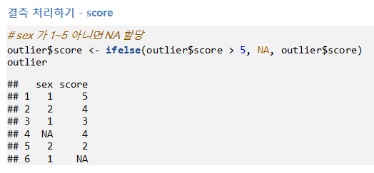
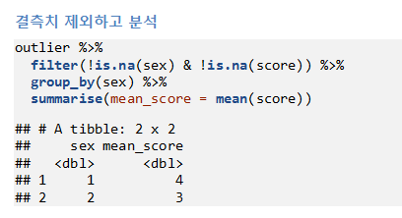
score가 1-5 아니면 제거

Slide 20
outlier<-data.frame(sex=c(1,2,1,3,2,1),score=c(5,4,3,4,2,6))
outlier
table(outlier$sex)
table(outlier$score)
outlier$sex<-ifelse(outlier$sex==3,NA,outlier$sex)
outlier
outlier$score<-ifelse(outlier$score>5,NA,outlier$score)
outlier
outlier %>% filter(!is.na(sex)&!is.na(score)) %>%
group_by(sex) %>%
summarise(mean_score=mean(score))

Slide 21
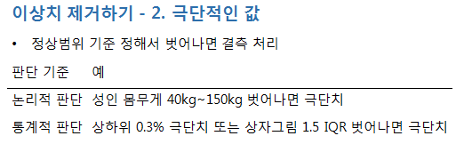
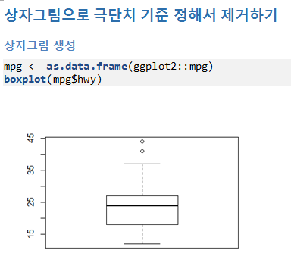

Slide 22
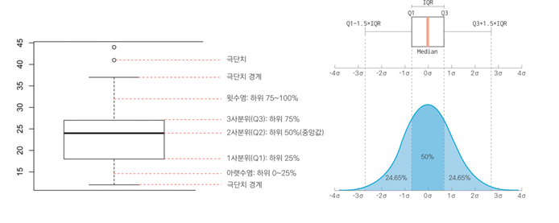
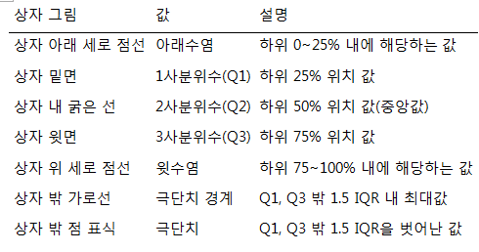

Slide 23
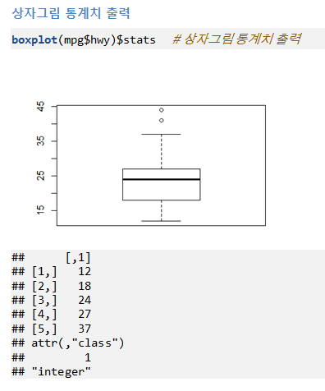

Slide 24
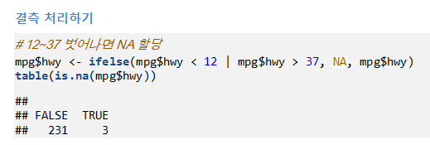
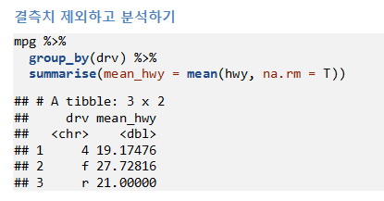

Slide 25
mpg<-as.data.frame(ggplot2::mpg)
boxplot(mpg$hwy)
boxplot(mpg$hwy)$stats
mpg$hwy<-ifelse(mpg$hwy<12|mpg$hwy>37,NA,mpg$hwy)
table(is.na(mpg$hwy))
mpg %>%
group_by(drv) %>%
summarise(mean_hwy=mean(hwy,na.rm=T))

Slide 26
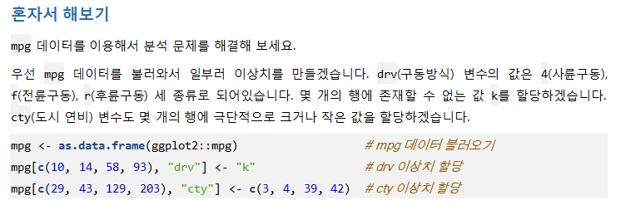
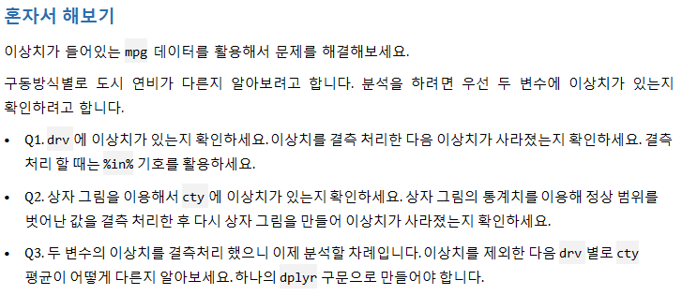

Slide 27
mpg[c(10,14,58,93),"drv"]<-"k"
mpg[c(29,43,129,203),"cty"]<-c(3,4,39,42)
table(mpg$drv)
mpg$drv<-ifelse(mpg$drv %in% c("4","f","r"),mpg$drv,NA)
table(mpg$drv)

Slide 28


Slide 29
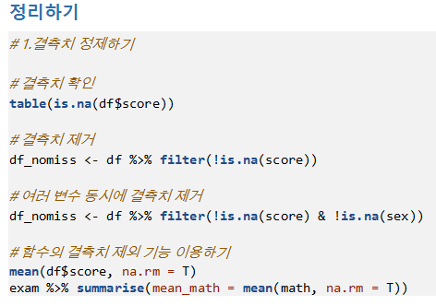

Slide 30
